Slide 1

Skew
Heap
CSC 172 Yutong He 4/13/2016

Slide 2
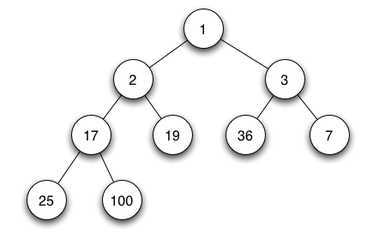
What is a skew heap???
This kind of heap???
NO!!!
Ha ha ha
Reference: https://en.wikipedia.org/wiki/Binary_heap

Slide 3
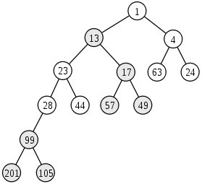
Skew heap is a self-adjusting heap data structure implemented as a binary tree, or we can say, a binary heap-ordered tree.
Reference: https://en.wikipedia.org/wiki/Skew_heap

Slide 4
What is this for???
To merge two array-based heap: O(N) time
To merge two node-based (tree-based) heap:
O(logN) time!!!

Slide 5
How does it happen???
We merge two skew heaps node by recursively call the merge method, which takes two skew heap nodes as parameters and returns a skew heap node.
Basic Step: if one of the skew heaps nodes is null, return the other one.
Recursive Step: if the first skew heap node (we call it n1) has higher or equal priority, which mean n1 has the smaller or the equal integer value in min heap, than the second heap node (we call it n2), merge the right child of n1 and n2 and let the new merged skew heap node be the new right child of n1. Then swap the left and right child of n1. Return n1 and end the method. If n1 has lower priority than n2, return the skew heap node created by calling merge method again but put n2 and n1 reversely in the parenthesis (i.e. originally calling merge(n1, n2), but now calling merge(n2, n1)).

Slide 6
In terms of code…
public MySkewNode<T> merge(MySkewNode<T> n1, MySkewNode<T> n2){
if(n1 == null){
return n2;
}else if(n2 == null){
return n1;
}else{
if(n1.data.compareTo(n2.data) <= 0){
MySkewNode<T> temp = n1.left;
n1.left = merge(n1.right, n2);
n1.right = temp;
return n1;
}else{
return merge(n2, n1);
}
}
}

Slide 7
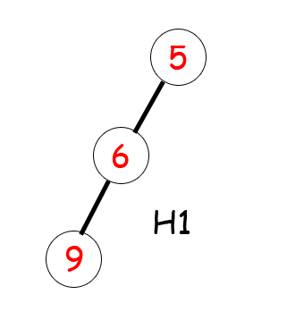
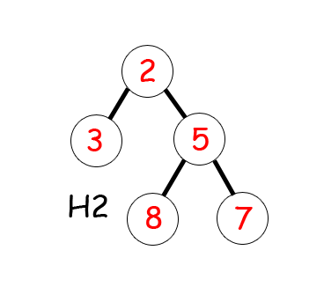
Let’s make it more straight forward!!!

Slide 8

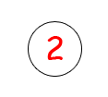
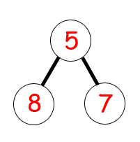

K.O.
X
Tie
X
X
K.O.

Slide 9
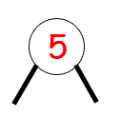
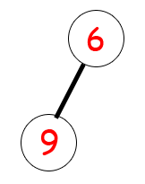


Slide 10



Slide 11
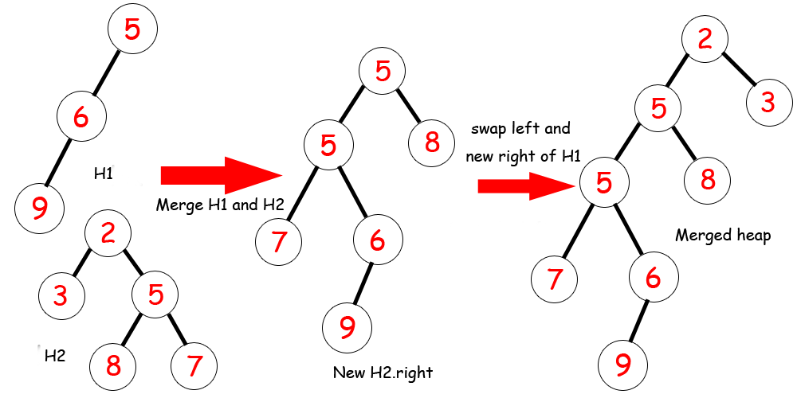

Slide 12
Super Easy!!!
Other method???
Insert: The insertion in skew heap is just a special case of merging – taking the new data as parameter and merging the new one-node skew heap with a normal skew heap.
Delete min: The deletion in skew heap is simply merging the left and right child, replacing the root by new merged heap, and returning the original root data.
Find min: The lookup or peek method in skew heap is simply returning the data of the root of the skew heap.
Merge two heaps: The merge two heaps method is a static method which creates a new skew heap instant and set the root of the new skew heap be the merged skew heap node of two roots of the two skew heaps it takes as parameters and return the new skew heap.

Slide 13
This is
Skew
Heap
Thanks for watching!!!

